Slide 1
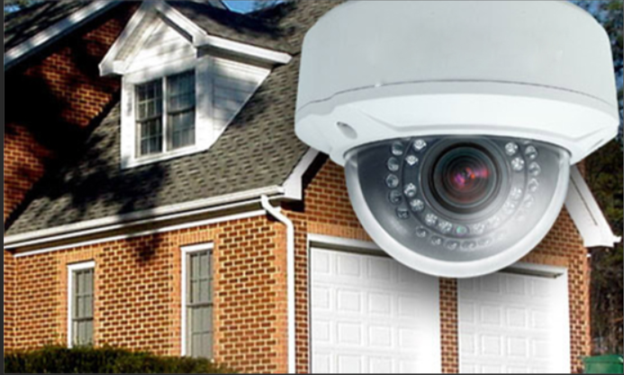
Presentation on Home Security….
Submitted By:
Shweta

Slide 2
Introduction
Securing entry points into home with sensors that communicate with a control panel or command centre installed in a convenient location.

Slide 3
Contents to be discussed
Different types of sensors
What happens when alarm rings
Block Diagram
Explanation using Example

Slide 4
Sensors
Door and Window Sensors:-Comprised of two parts installed adjacent to each other .If it is closed ,security circuit remains created otherwise gets broken…and alarm starts.
Motion Sensors:-these protect a given space by creating an invisible zone that cannot be breached without sounding an alarm.
Surveilllance Cameras……and many more

Slide 5
What happens when alarm rings….
Professionally monitored Security Systems:-Alarm Company gets alerted when alarm rings….A trained security expert might attempt to communicate with the home owner.
Non Monitored security system:-In the event of home intrusion,alarm sounds….Contacting police,fire or other emergency response must be initiated by the homeowner,

Slide 6
Block Diagram
Sensor
Monitoring System
Sensor
Control
Panel
Sensor

Slide 7
Introduction
Camera takes pictures
Compares with database
Reveals--person is authorized or not.
Uses IOT-Internet of Things

Slide 8
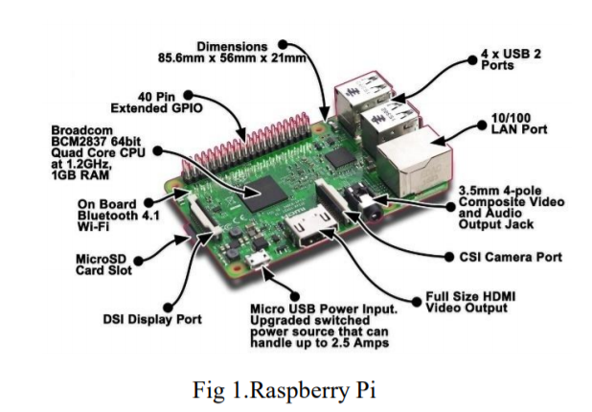
Equipments….
Raspberry Pi-----Mini Computer
Camera
Laptop or Smart phone

Slide 9
Working
Camera is connected to USB Port of RPI
Grey Scale conversion of images – Serve as database
Laptop connected with RPI using same IP address.

Slide 10
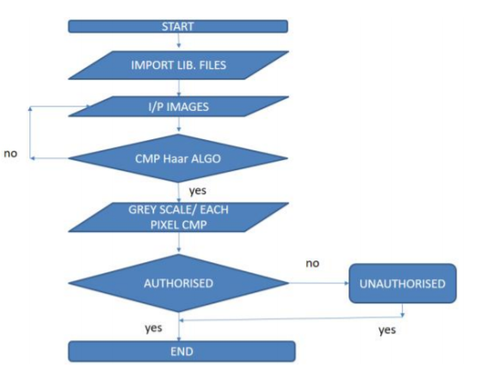
Haar Algorithm

Slide 11
Conclusion
So, all in all by this we can remotely manage our house
As well as we can typically arm and disarm system from anywhere in the world via a web enabled device.

Slide 12
References
Y.Upadhyay, A.Borole, and D. Dileepan. Mqtt based secured homeautomation system. In2016 Symposium on Colossal Data Analysis and Networking (CDAN), pages 1–4, March 2016.
V.Ghule and S. Sakhare. Smart organization.In2017 IEEE 7 th International Advance Computing Conference (IACC), pages 826–830,Jan 2017.
S.Lee, N.Lee, J.Ahn, J.Kim, B. Moon, S. h. Jung, and D. Han.Construction of an indoor positioning system for home iot applications.In2017 IEEE International Conference on Communications (ICC),pages 1–7, May 2017.

